Slide 1


MotoMetric
COMPREHENSIVE VEHICLE DATA AND PRE-OWNED MARKET PLATFORM

Slide 2

Motometric: Your Compass In The World Of Wheels
1
Our Mission and Vision
it is a revolutionary online platform dedicated to providing enthusiasts, buyers, and sellers with unparalleled access to the world of vehicles. From comprehensive vehicle details and effortless test drive bookings to seamless used car sales and intuitive fuel cost calculations, Moto metric redefines the automotive experience. With our user-friendly interface and cutting-edge features, Moto metric is poised to become your go-to resource for all your automotive needs.

Slide 3
Motometric is a comprehensive dual-partitioned website
1.Comprehensive Vehicle Data
2.Pre-Owned Marketplace
Delivering detailed and comprehensive information about vehicles' specifications .
Creating a platform to facilitate the buying and selling of pre-owned vehicles with ease.

Slide 4
Key Features of Motometric
1
Comprehensive Vehicle Database
2
Interactive Comparison Tool
3
Pre-Owned Marketplace
Access detailed specifications and pricing information for a wide range of vehicles, empowering informed decision-making.
Easily compare multiple vehicles side by side, empowering users to make informed decisions based on key features and specifications.
Seamlessly buy and sell pre-owned vehicles, connecting buyers and sellers directly for hassle-free transactions.
4
Forum
Share experiences and connect with fellow car enthusiasts in our dynamic forum community

Slide 5

Benefits for Users
Empowering Decision Making
Free Access for All Users
Unlimited access to all features and content on the website is completely free of charge for all users.
Gain access to extensive vehicle data to facilitate well-informed decision-making processes.
Connecting Buyers And Sellers Around The World
Facilitating seamless connections between buyers and sellers, our platform streamlines the process of buying and selling vehicles, ensuring efficient transactions

Slide 6
Modules:
User Registration
Search
Used Cars
Comparison
Test Drive Booking
Car Listing and Details
Forum

Slide 7
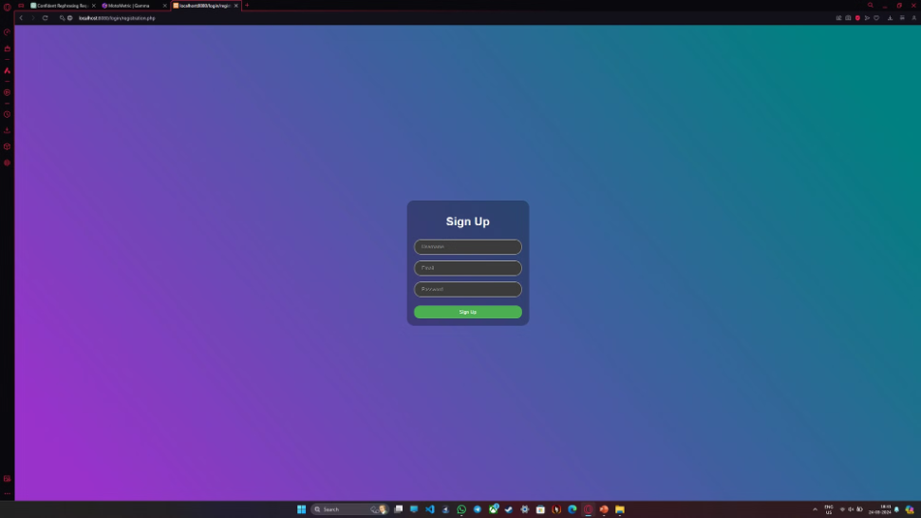
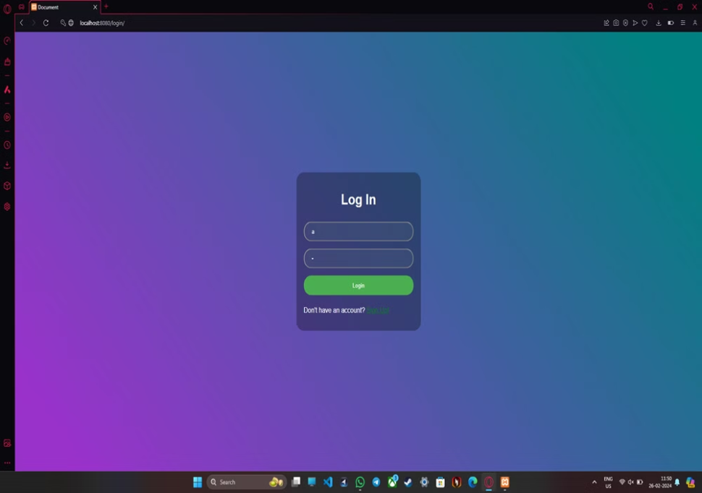
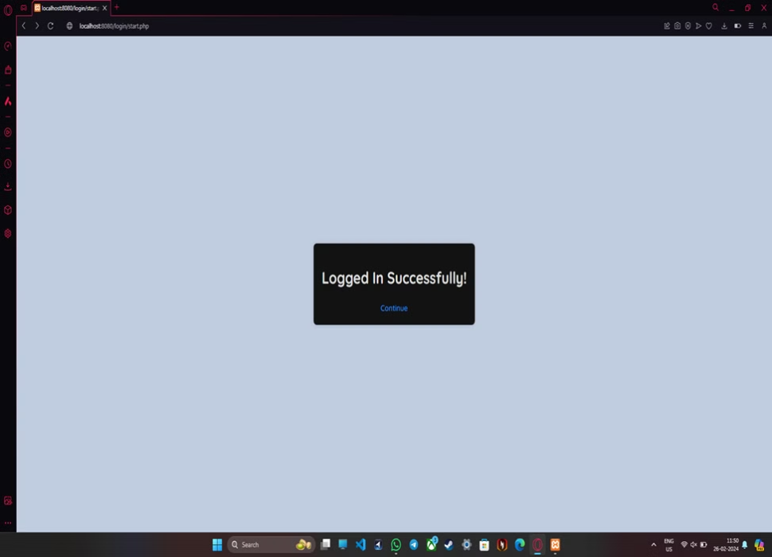
1.User Registration
Seamlessly sign up for an account to unlock the full potential of our website.

Slide 8
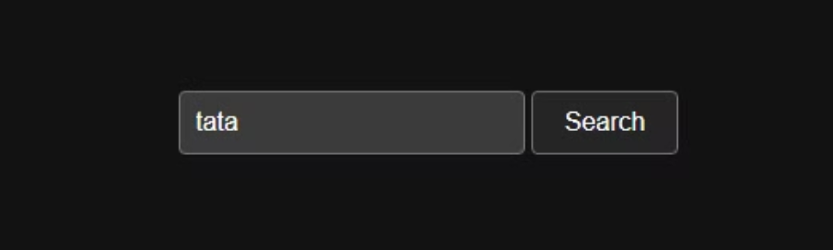
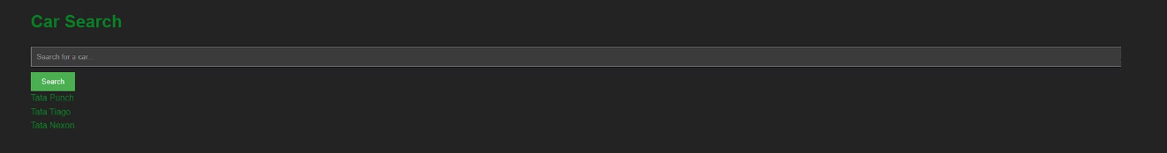
2.Search
Easily find the information you need with our intuitive search functionality, enabling quick access to a vast database of car-related content.

Slide 9
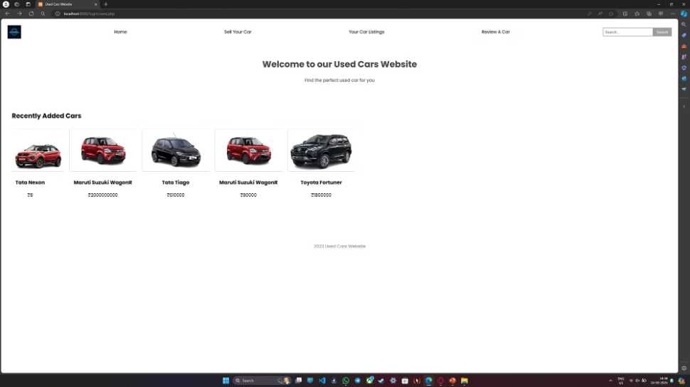
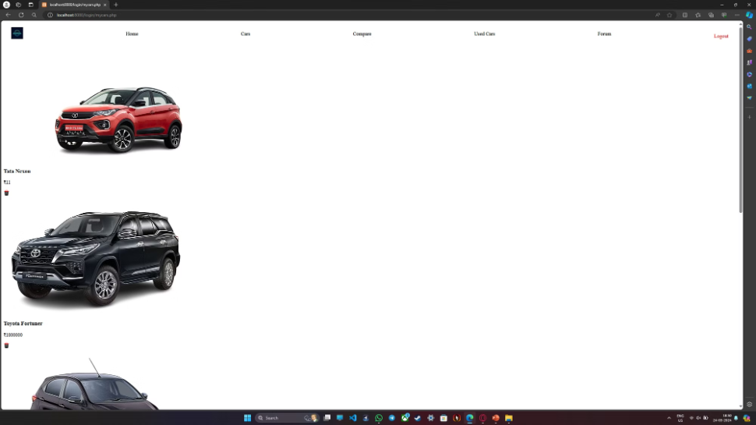
3.Used Cars
Browse through a diverse selection of pre-owned vehicles, with detailed listings and comprehensive information to help you find the perfect match.

Slide 10
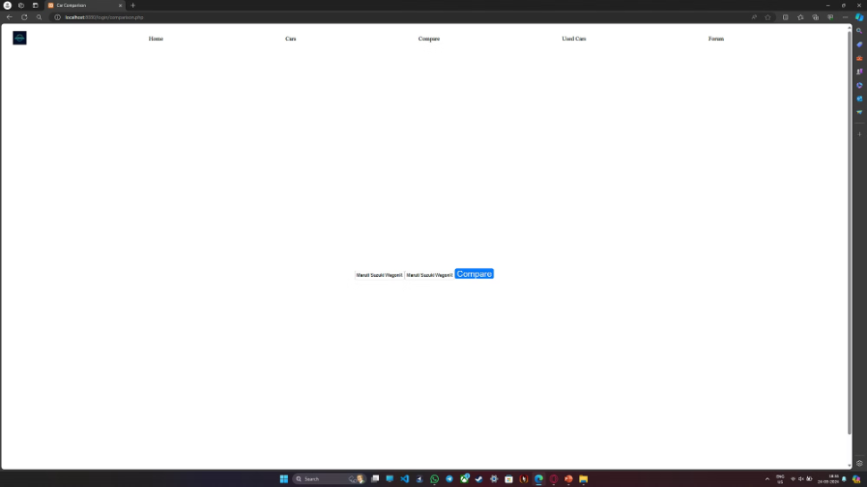
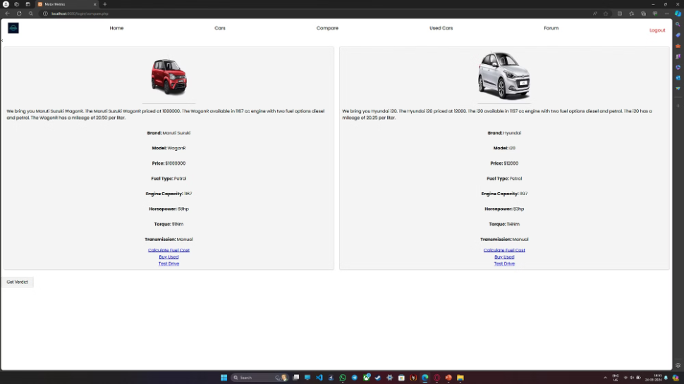
4.Comparison
Compare multiple vehicles side by side, evaluating key features and specifications to make an informed decision.

Slide 11
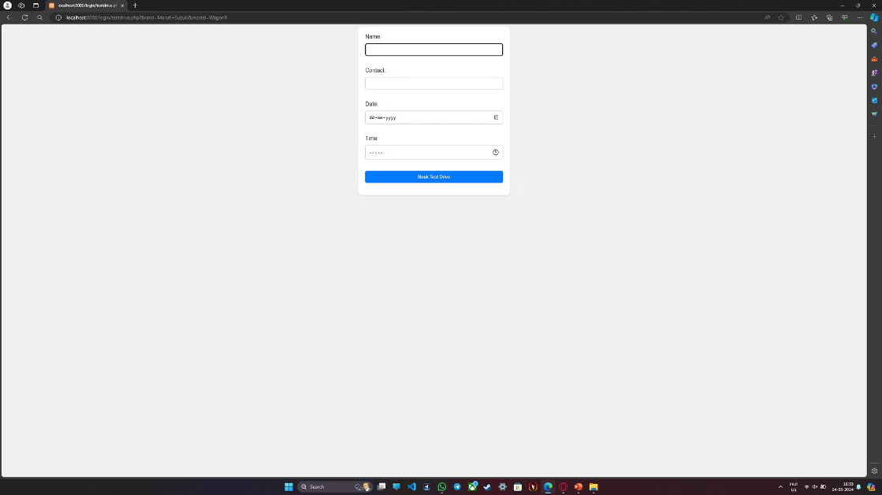
5.Test drive Booking
Schedule test drives for your preferred vehicles directly through our platform, making it convenient to experience them firsthand.

Slide 12
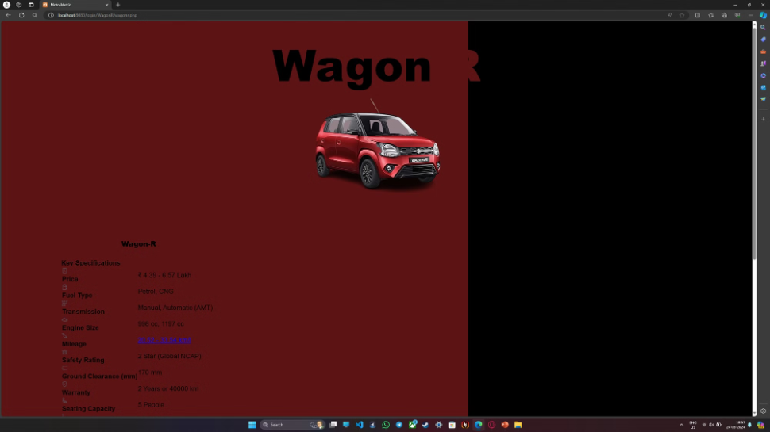
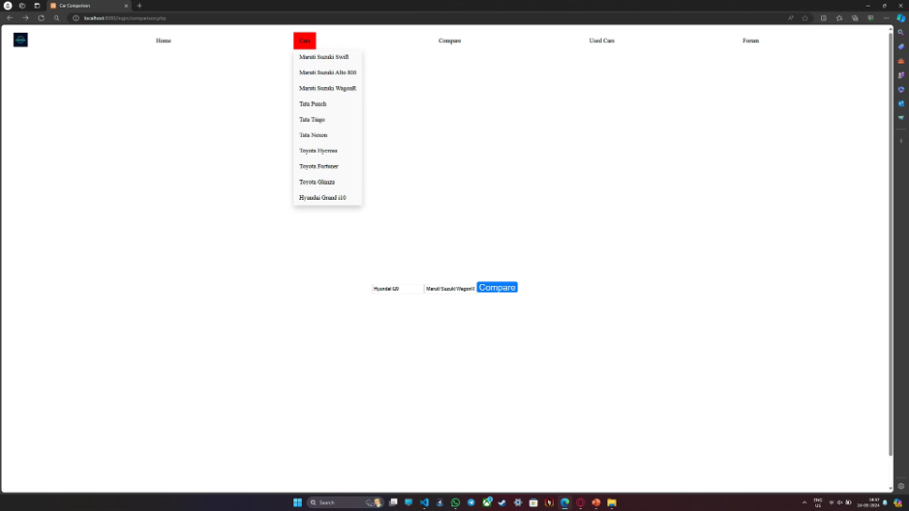
6.Car Listing and Details
Explore comprehensive listings of new and used cars, complete with detailed specifications, pricing, and images to guide your purchasing journey.

Slide 13
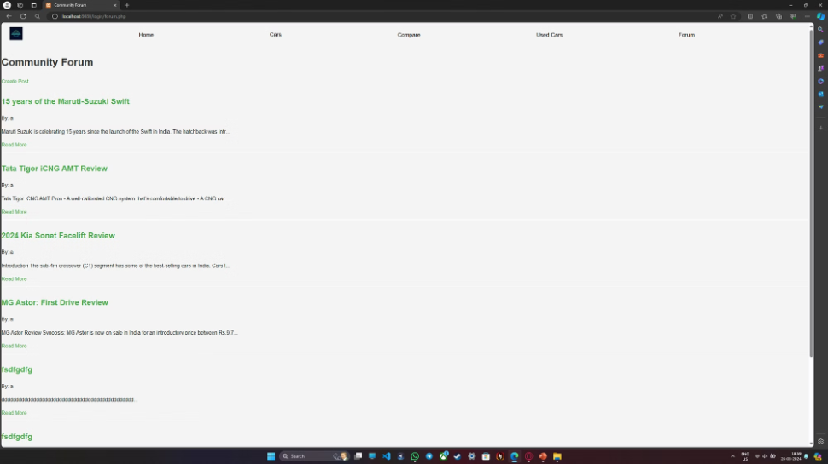
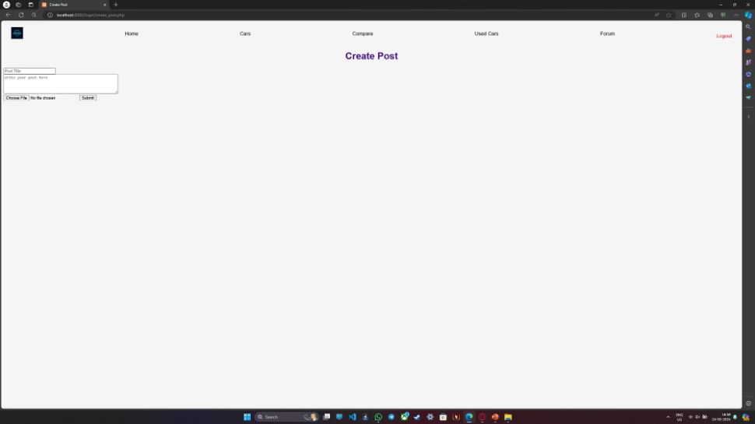
7.Forum
Share experiences and connect with fellow car enthusiasts in our dynamic forum community

Slide 14
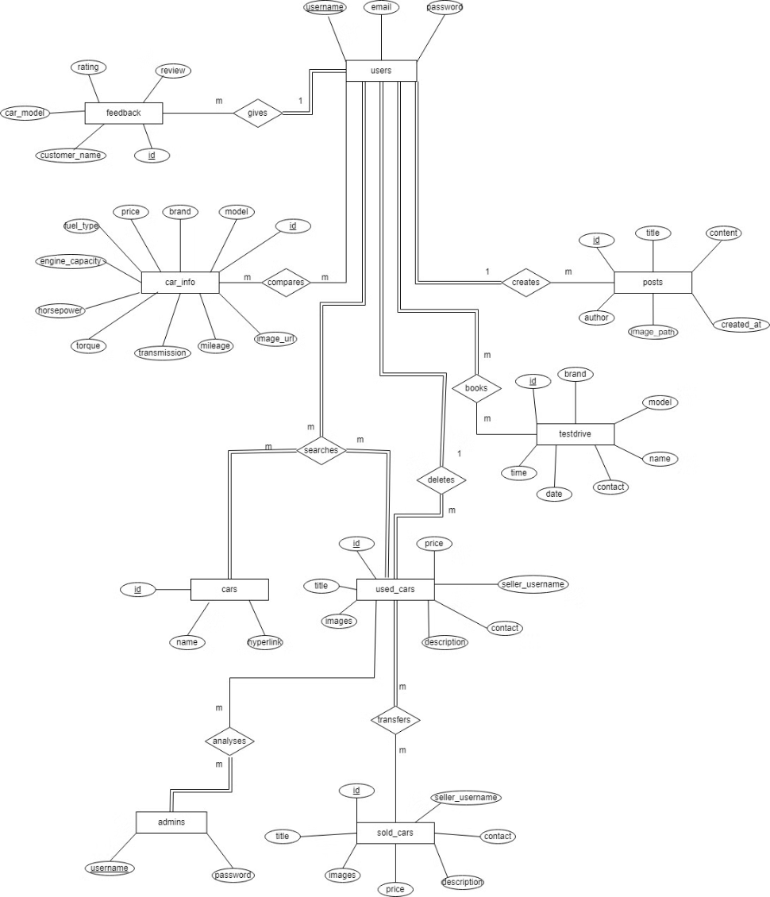
Entity Relationship Diagram
An entity-relationship model (ER model) is a data model for describing the data or information aspects of a business domain or its process requirements, in an abstract way that lends itself to ultimately being implemented in a database such as a relational database.

Slide 15
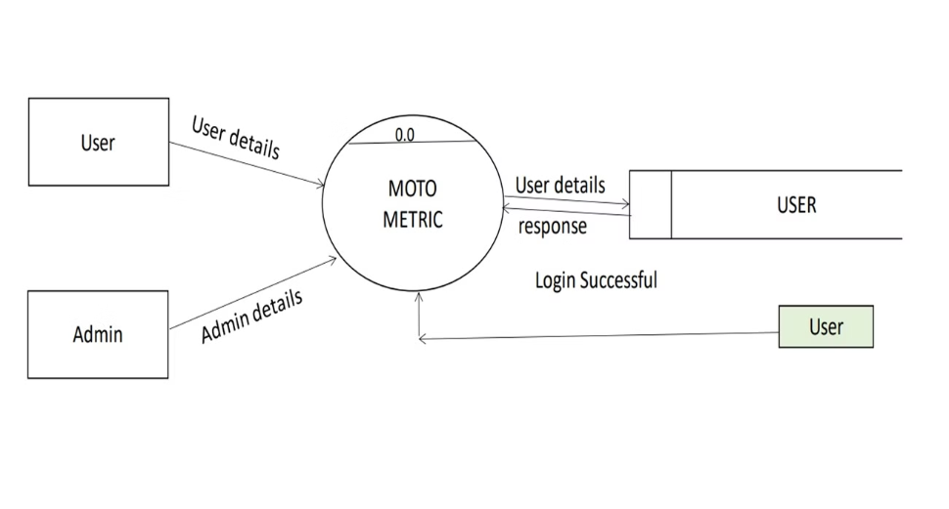
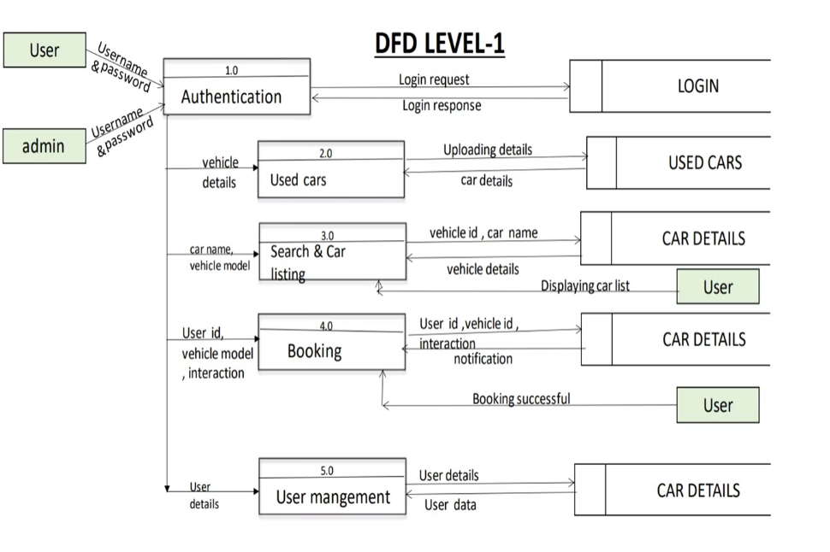
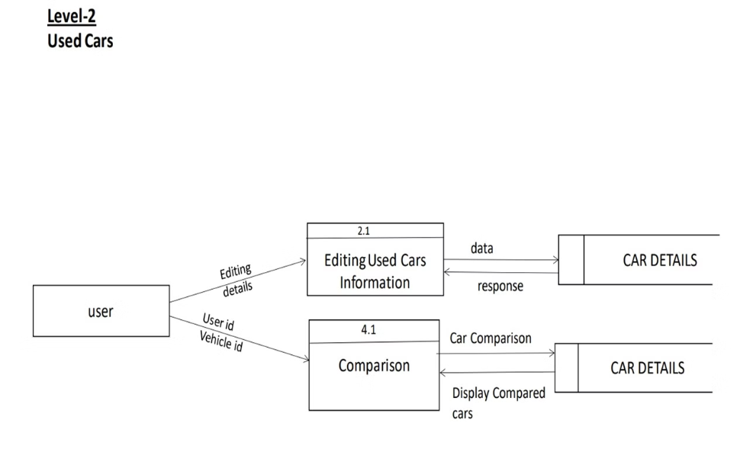
Data Flow Diagram
Data Flow Diagram is a visual representation that illustrates the flow of data within a system, showing how information moves between processes, data stores, and external entities.
Level 0 DFD
Level 0 DFD: Also known as the context diagram, it provides an overview of the entire system, showing the interactions between the system and external entities.
Level 1 DFD
Subsequent levels provide more detailed views of specific parts of the system. Each lower level expands on the processes and data flows identified in the higher-level diagrams, providing a deeper understanding of the system's functionality.
Level 2 DFD

Slide 16







Tools And Technologies Used
1.PHP
PHP (Hypertext Preprocessor) is a server-side scripting language widely used for web development.
2.CURSOR
Cursor IDE is a comprehensive integrated development environment (IDE) designed to streamline the software development process. With a focus on simplicity and productivity, Cursor IDE offers a range of features to support coding, debugging, and collaboration.
3.Java Script
JavaScript is a versatile and widely used programming language that is primarily known for its role in web development. Originally developed by Netscape, JavaScript has evolved over the years and become a crucial technology for creating dynamic and interactive content on the web.
4.HTML
HTML (Hypertext Markup Language) is a standard markup language used to create the structure and present content on the World Wide Web. Developed by Tim Berners-Lee in the early 1990s, HTML serves as the backbone for web development, providing a standardized way to describe the structure and semantics of web documents.
5.Maria DB
MariaDB is an open-source relational database management system (RDBMS) that was forked from MySQL. It is developed by the MariaDB Corporation and the MariaDB Foundation, led by Michael "Monty" Widenius, one of the original developers of MySQL. MariaDB aims to maintain open-source freedom and guarantee backward compatibility with MySQL, while also introducing new features and improvements.
6.XAMPP
XAMPP is a free and open-source cross-platform web server solution stack developed by Apache Friends. The name "XAMPP" is an acronym, where "X" stands for cross-platform, "A" for Apache (the web server), "M" for MariaDB or MySQL (the database system), "P" for PHP (the programming language), and "P" for Perl (another programming language).
7.VS CODE
Visual Studio Code, also commonly referred to as VS Code, is a source-code editor made by Microsoft with the Electron Framework, for Windows, Linux, and macOS. Features include support for debugging, syntax highlighting, intelligent code completion, snippets, code refactoring, and embedded Git.
Front End:
HTML,CSS,JavaScript
Back End:
PHP,MariaDB

Slide 17
Relevance
Our project's relevance lies in its ability to address the needs and interests of our target audience, as well as its potential to contribute positively to the automotive community. Our platform empowers users to make informed decisions when buying or maintaining cars by providing them with comprehensive information, educational resources, and interactive features such as comparison tools and test drive bookings. Through our forum module, we foster a sense of community among car enthusiasts, allowing them to share experiences and connect with like-minded individuals. Additionally, we contribute to the education of users by providing valuable resources such as maintenance tips, DIY repair guides, and technological insights. By offering a user-friendly platform with intuitive navigation, interactive features, and engaging content, we enhance the overall user experience, making it easy and enjoyable for users to explore and interact with our website

Slide 18
Our Objectives
To provide a comprehensive platform for car enthusiasts to access detailed specifications, reviews, and insights into various car models, empowering them to make informed decisions when buying or maintaining cars.
To foster a vibrant community of car enthusiasts through our forum module, share experiences, and connecting like-minded individuals with a passion for cars.
To contribute to the education of users by providing valuable resources such as maintenance tips, DIY repair guides, and technological insights, enhancing their knowledge and skills in the automotive domain.
To enhance user experience by offering a user-friendly platform with intuitive navigation, interactive features, and engaging content, making it easy and enjoyable for users to explore and interact with our website.
To continuously improve and refine our platform based on user feedback and iteration results, ensuring that we meet the evolving needs and expectations of our users while striving for excellence in the automotive community."

Slide 19
Methodology
Iterative Methodology:
In our project, we follow an iterative approach to software development. This methodology involves breaking down the project into smaller cycles or iterations, each delivering a working version of the product. With each iteration, we gather feedback, incorporate changes, and refine the product further. This iterative process allows us to adapt to changing requirements, improve quality, and deliver value incrementally, resulting in a more flexible and responsive development approach.

Slide 20
Advantages And Disadvantages
Advantages:
Comprehensive Information: The website provides detailed specifications and features of various car models, serving as a one-stop resource for car enthusiasts.
Educational Content: The website offers educational resources such as maintenance tips and DIY repair guides, empowering users with valuable knowledge about car ownership and maintenance.
Free Access: The website is completely free to use for all users, ensuring accessibility to valuable information and resources without any cost barriers.
Interactive Tools: Interactive features like the comparison tool and test drive booking enhance user experience and help users make informed decisions when researching and purchasing cars.
Disadvantages:
Lack of Chat Option: The absence of a chat feature limits real-time interaction between users, potentially hindering immediate support or spontaneous discussions.
Maintenance: Keeping the website updated with accurate information and moderating user-generated content in the forum module may require ongoing effort and resources.
User Trust: Ensuring the accuracy and reliability of user-generated content, such as reviews and forum posts, is crucial for maintaining user trust and credibility.
Lack of Collaboration with Dealerships: The absence of partnerships with dealerships limits access to real-time inventory updates and exclusive deals, potentially impacting the website's ability to provide comprehensive and up-to-date information to users.

Slide 21
Conclusion
In conclusion, our project aims to revolutionize the car enthusiast experience by providing a comprehensive platform for accessing vehicle information, fostering community engagement, and promoting education in the automotive domain. With user-friendly features and valuable resources, we strive to create an immersive and enjoyable experience for users while continuously improving and adapting to meet their evolving needs. Together, let's embark on this journey to explore the exciting world of cars and connect with like-minded enthusiasts. Thank you for joining us on this adventure!

